Slide 1
Predicting House Price
Prepared by: Mohammed Hamoud Alharbi

Slide 2
Presentation Outline
Introduction
Dataset
Data Cleaning
EDA
Modelling
conclusion

Slide 3
introduction
Many parties, including owners, buyers, agents, and investors, face difficulties in accurately determining the value of the house. It's also a challenging one. Though it is common known that size, number of rooms, and age of the house influence pricing, there are many additional factors at play. Additionally, prices are sensitive to changes in market demand and the peculiarities of each situation, such as when a property needs to be urgently sold. The sales price of a property can be predicted in various ways, but is often based on regression techniques. In this presentation, predicting the selling price of houses based on a number of features such as the area, the number of bedrooms, the area income and house age, number of rooms and etc.

Slide 4
Dataset
Source
From kaggle
Rows
Consists of 5000 rows
columns
Consists of 7 columns
size
726.21 KB

Slide 5
Data cleaning
Load dataset
Check
Rename
Drop
Load dataset to our project to make analysis and predictions
Check the dataset if these are some missing or duplicated data
Change columns names to easy and clear names
Drop unwanted columns

Slide 6
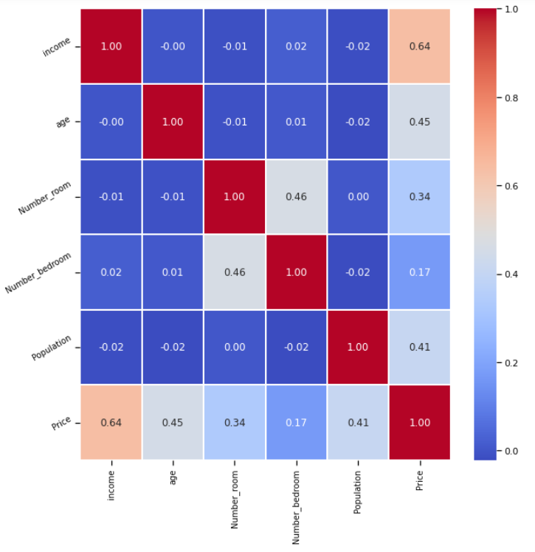
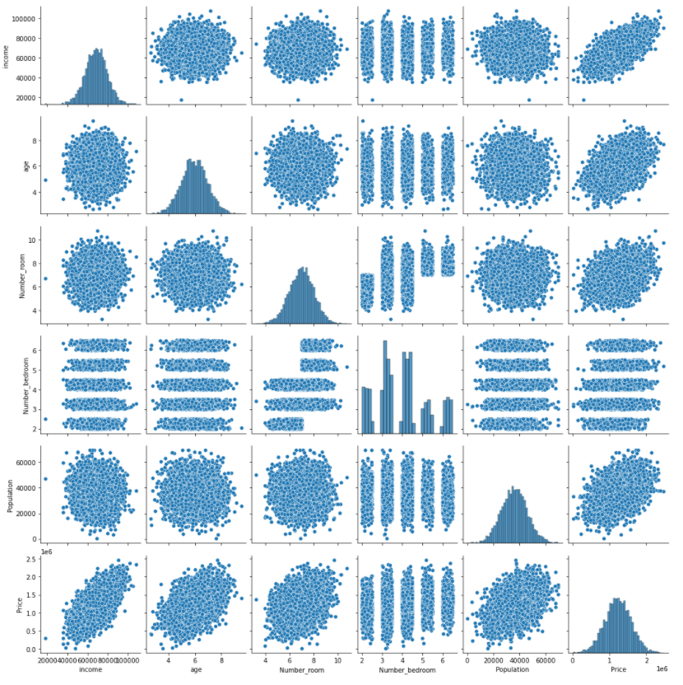
Exploratory Data Analysis

Slide 7
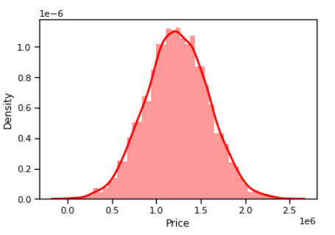
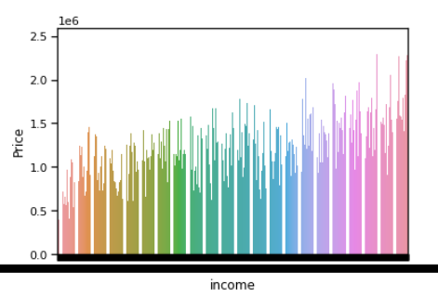
Exploratory Data Analysis

Slide 8
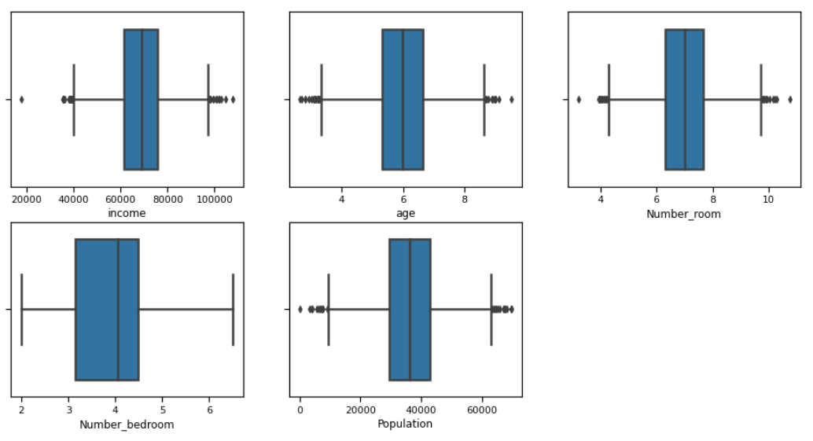
Exploratory Data Analysis

Slide 9

Linear Regression Model
Machine learning Model

Slide 10
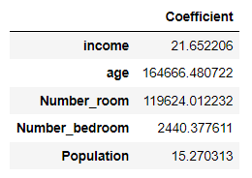
Evaluate the model by checking out its coefficients and how we can interpret them
One unit increase in Income is associated with an increase of $21.65 .
One unit increase in Age is associated with an increase of $164666.48 .
One unit increase in Number_Rooms is associated with an increase of $119624.01 .
One unit increase in Number _Bedrooms is associated with an increase of $2440.37 .
One unit increase in Population is associated with an increase of $15.27 .

Slide 11
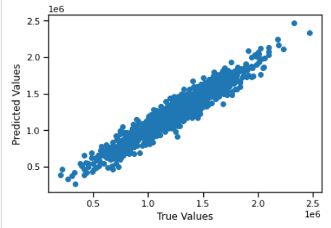
Prediction results
In this scatter plot, we see data is in a line form, which means our model has done good predictions.

Slide 12
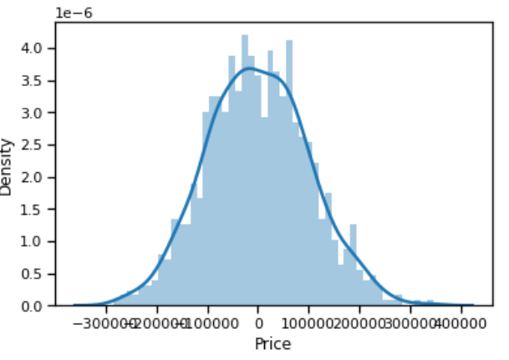
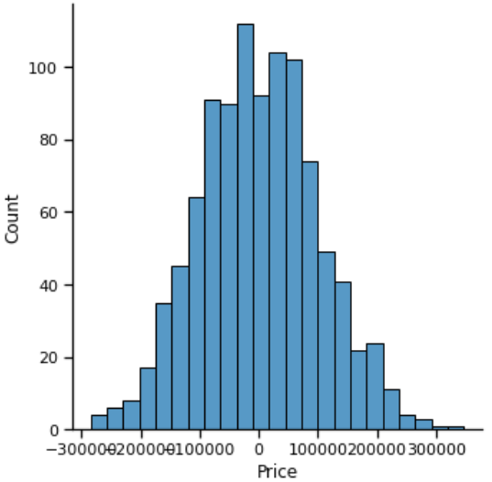
Prediction results
In this histogram plot, we see data is in bell shape (Normally Distributed), which means our model has done good predictions.

Slide 13
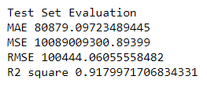
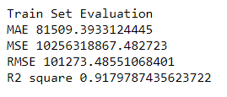
Regression Evaluation

Slide 14
conclusion
To sum up: predicting the selling price of houses in this project based on a number of factors such as the area, the number of bedrooms, the area income, house age, number of rooms and etc. So that would help real estate to estimate the houses prices.

Slide 15

Tools
Pandas
Seaborn
NumPy
Matplotib
Scikit-learn

Slide 16
Do you have any questions?

